Slide 1




Macrosystems EDDIE: Cross-Scale Interactions
Carey, C.C. and K.J. Farrell. 13 August 2017.
Macrosystems EDDIE: Cross-Scale Interactions.
Macrosystems EDDIE Module 2, Version 2.
http://module2.macrosystemseddie.org
Module development was supported by NSF EF 1702506.
Notes:
Welcome the students to class. It might be helpful to go around the room and briefly discuss if anyone has experience programming or modeling. The point of this is to emphasize that most students are likely novices, and that asking lots of questions is ok because their peers are novices as well.
It is really important at this point to emphasize that there will be lots of new material covered during this module, and that going slowly and asking for help is very much encouraged!
We generally try to organize the classroom so that students with similar operating systems (e.g., Mac vs PC) can work together; this module asks students to work in pairs and share data among a team of two pairs each.

Slide 2
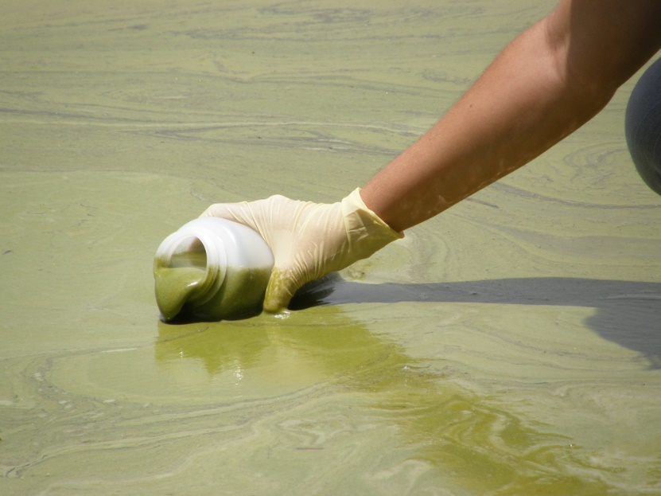
Plan for today:
Short overview on changing water quality in lakes globally, and how we can use a macrosystems ecology and lake modeling approach to study this problem!
Activity A: Run and explore a lake water quality model in R.
Activity B: Select a climate scenario, generate hypotheses, and model how different lakes respond.
Activity C: Model the effects of climate and land use change scenarios on different lakes, and make predictions about drivers of phytoplankton blooms at large spatial scales.
Nara Souza, Florida Fish and Wildlife Commission
Notes:
Quick road map of what will be covered in the PowerPoint

Slide 3
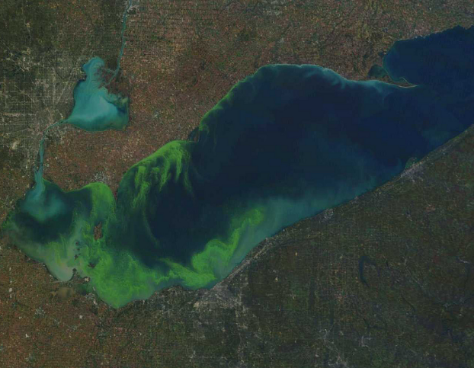
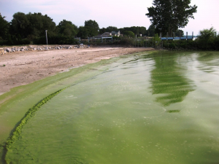
Phytoplankton blooms increasing globally
Blooms occur when phytoplankton populations rapidly increase
Result in turbid water, surface scums
Pose a major water quality threat to drinking water
Many bloom-forming species produce toxins harmful to humans and other animals
Bacteria decomposing dead phytoplankton consume large quantities of oxygen
“Dead zones” of low oxygen & fish kills
NASA Visible Earth
NOAA
Notes:
Why do we want to know about how phytoplankton blooms in lakes? Has anyone ever seen a surface scum of phytoplankton on a lake before?

Slide 4
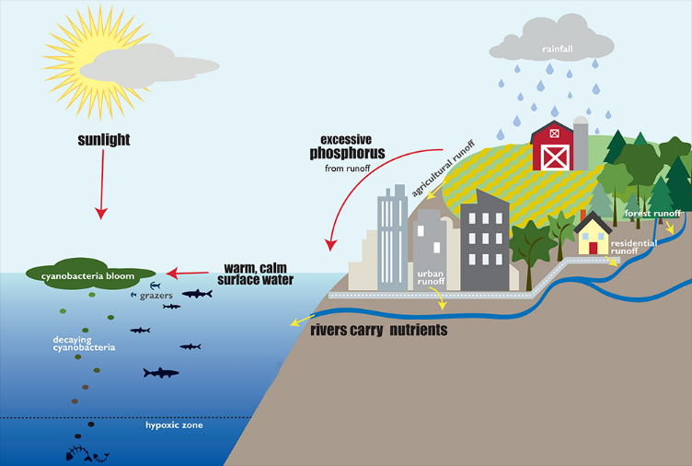
What are the drivers of these blooms?
Land use change
Changing forest into agricultural fields or urban areas increases the amount of phosphorus (P) flowing into lakes
Phosphorus stimulates phytoplankton growth
Warming climate
Many phytoplankton species thrive in warmer waters
Image modified from: Lake Champlain Basin Program (sol.lcbp.org)
Notes:
Today, we are going to focus specifically on the timing and intensity of phytoplankton blooms in different lakes.
The two major drivers of blooms in most lakes are land use change and warming climate.
The tricky thing is that while land use change and climate warming are occurring globally, they are not occurring in the same way for all lakes: some lakes may be experiencing more warming (or even cooling!) and other lakes may be experiencing more severe land use change than others. Consequently, we need new ways to think about how these two drivers may interact at different temporal and spatial scales to affect water quality in lakes.

Slide 5
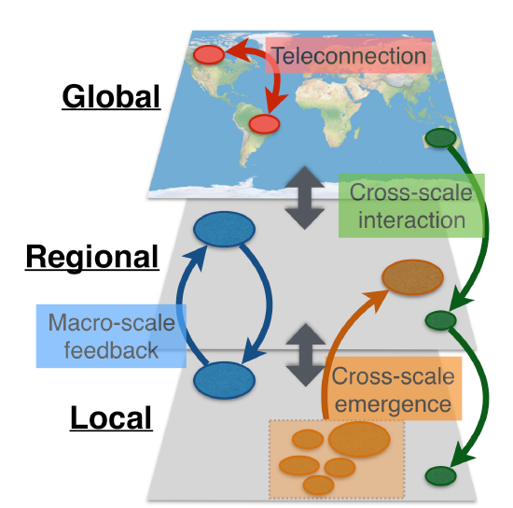
Using a macrosystems ecology approach to study phytoplankton blooms
Drivers of blooms occur at both local and regional scales
Local = e.g., land use
Regional = e.g., climate change
Macrosystems ecologists study ecological dynamics and feedbacks at multiple interacting spatial and temporal scales
We can study local and regional drivers using high frequency sensor data + simulation models
Figure modified from: Heffernan et al. 2014
Notes:
Drivers of phytoplankton blooms occur at both local and regional scales: e.g., the temperature and nutrient concentrations of inflowing streams and groundwater are local factors, whereas weather/climate patterns tend to be regional.
Looking at the effects of drivers operating at multiple scales uses a macrosystems ecology approach, which entails studying ecological dynamics and feedbacks across multiple spatial and temporal scales.
Here, we are using a macrosystems approach combining high-frequency sensor data and simulation models to compare the effects of local and regional drivers on lake phytoplankton blooms.

Slide 6
Cross-scale interactions: What are non-linear responses?
Cross-scale interaction: processes at one scale interact with processes at another scale, which can sometimes create non-linear responses
Non-linear responses occur when the change of an output is not proportional to the change of the input
Responses may appear unpredictable or counterintuitive
Figure modified from: Heffernan et al. 2014
Notes:
Ask students if anyone can describe what cross-scale interactions are, or if they can give an example.
The part to emphasize here is that when drivers that occur at different scales interact, they can result in non-linear responses, where the change in an output we observe is not always proportional to the change we observed in the input. This can make cross-scale interactions seem unpredictable or counterintuitive.
We note that not all cross-scale interactions are non-linear, but many are, which makes studying cross-scale interactions important for understanding ecosystem responses to climate and land use change.

Slide 7



Cross-scale interactions: Example
A non-ecological cross-scale interaction could occur when trying to predict a farmer's income for a particular year.
Local weather affects how well crops will grow
Global demand for crops affect market prices
These two factors operate on very different scales, and interact to affect a farmer's income
It would be very difficult to predict the interactive effects of local & global factors on farmer income by looking at them in isolation
+
Notes:
A non-ecological example of a cross-scale interaction could be when trying to predict a corn farmer's income for a year. Local weather and global crop markets operate a very different spatial and temporal scales, but they interact across these scales to affect farmer income.
Trying to predict a farmer's income a priori from just local or global drivers alone would be very difficult.

Slide 8
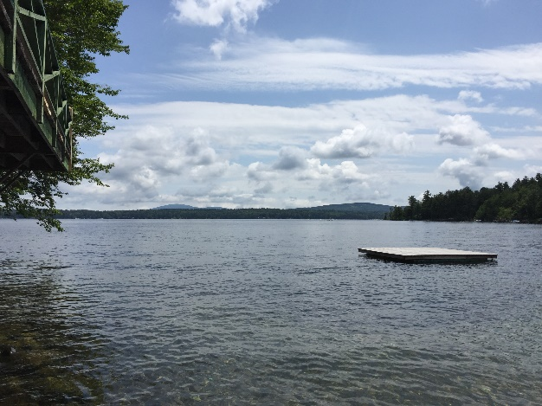
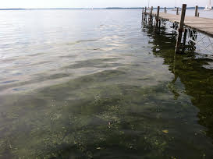
Cross-scale interactions in lakes
Phytoplankton blooms exhibit cross-scale responses to regional warming climate and locally-increasing lake nutrients due to land use change
Bloom severity and timing can be difficult to predict due to cross-scale responses to climate + land use
Moreover, cross-scale interactions prevent us from predicting whether an algal bloom will occur in a particular lake by looking at climate change or land use change alone
C.C. Carey
C.C. Carey
Notes:
Phytoplankton blooms can be an example of cross-scale interactions in lakes: we know that climate and nutrients contribute to blooms, but the importance of these drivers on bloom formation varies among lakes substantially. Some lakes may be exhibiting blooms due to land use change, some lakes may be exhibiting blooms due to climate change, and some lakes may be exhibiting blooms due to the interaction between both land use (a local factor) and climate change (a regional factor) occurring simultaneously.

Slide 9
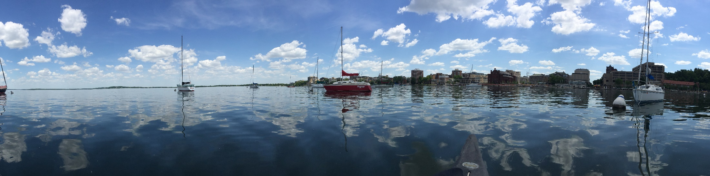
Our focal question:
How will changes in land use and climate interact at local and regional scales
to affect lake water quality, specifically, the timing and intensity
of phytoplankton blooms?
Image: K.J. Farrell
Notes:
Today, we are going to focus specifically on how changes in land use and climate interact at local and regional scales to affect water quality, specifically, the timing and intensity of phytoplankton blooms. We are going to model different lakes, and see if cross-scale interactions of blooms occur in multiple lakes experiencing climate and land use change simultaneously.

Slide 10
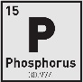

Models to understand multiple drivers
How can we test the effects of drivers from different spatial scales on lake phytoplankton blooms?
Impossible to experimentally manipulate all possible climate and land use drivers in a real lake!
Simulation modeling allows us to explore what would happen if we changed one driver, or multiple drivers at once:
For example, how would phytoplankton bloom severity change if air temperatures were 2°C warmer than they are now? 4°C? 6°C?
What if phosphorus inputs to the lake increased or decreased?
+2°C
+4°C
+6°C
Notes:
To study the effects of climate and land use change on lakes, researchers use models, because it is impossible to manipulate factors such as solar radiation, air temperatures, and inflowing stream nutrients on real-world lakes at the whole-lake scale in a controlled way.
However, simulation modeling allows us to test how changes in one or more drivers alters lake chlorophyll-a concentrations. Simulation models allow us to manipulate weather and land use change in a computer, and test the effects of lots of modeling experiments. For example, an experiment could be if air temperatures increased by 2°C.

Slide 11

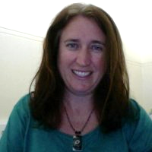
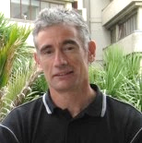
GLM: General Lake Model
Authors: Matt Hipsey, Louise Bruce, and David Hamilton
The General Lake Model (GLM) is an open-access model for simulating lake dynamics. It simulates vertical stratification and mixing and accounts for the effect of inflows/outflows, surface heating and cooling.
GLM has been designed to be an open-source community model developed in collaboration with members of the Global Lake Ecological Observatory Network (GLEON) to integrate with lake sensor data.
Available from: http://aed.see.uwa.edu.au/research/models/GLM/
Notes:
The simulation model we are going to use is GLM (the General Lake Model), which was developed in 2012 as an open-source model by researchers in GLEON, the Global Lakes Ecological Observatory Network.
GLM gives us the opportunity to do climate change experiments, in which we modify different climate conditions and study their effects on the lake.

Slide 12
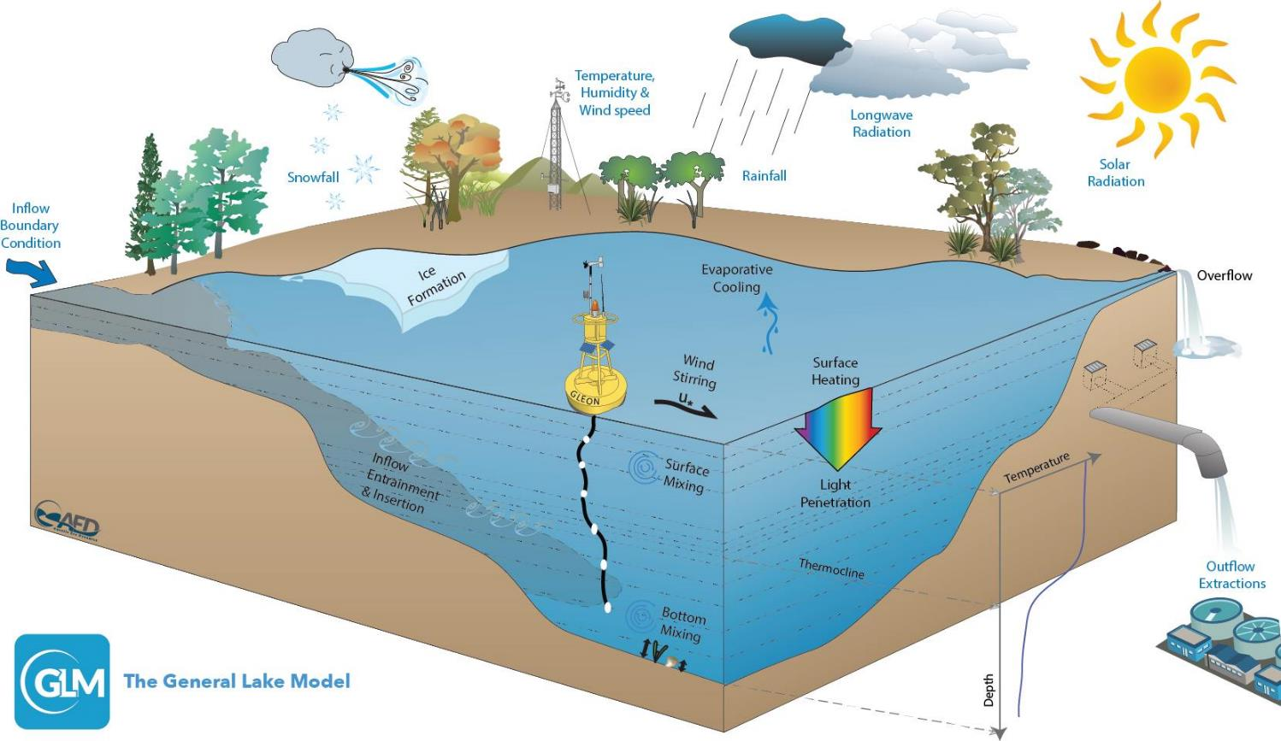
Figure: Hipsey et al. 2014
Notes:
GLM is a lake physics model, which uses climate forcing data as input (e.g., inflows, snow, wind, temperature, humidity, radiation) and models lake thermal structure, with lake temperature profiles as output.

Slide 13
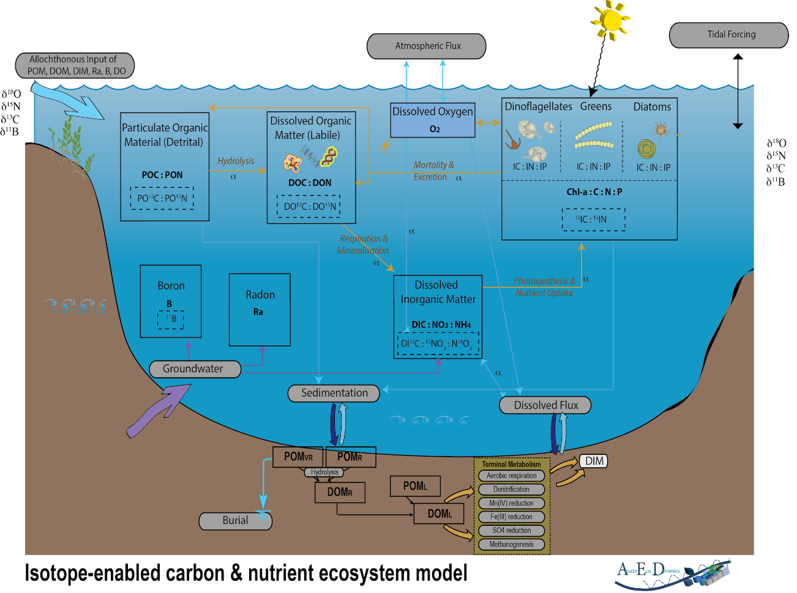
AED: Aquatic EcoDynamics
The Aquatic EcoDynamics (AED) module couples with GLM to model changes in water chemistry and biology
Can model nutrient, phytoplankton, and zooplankton dynamics
Today, we’ll focus on phytoplankton (as chlorophyll-a)
Figure: Hipsey et al. 2013
Notes:
GLM has a water quality module called Aquatic EcoDynamics (AED) that we will use today to model water chemistry and biology dynamics in lakes. We couple GLM and AED to simulate water quality.
We will be using AED to look at how chlorophyll-a concentrations change in the lake over time and under different climate and land use scenarios. Chlorophyll a is a proxy for phytoplankton biomass.

Slide 14
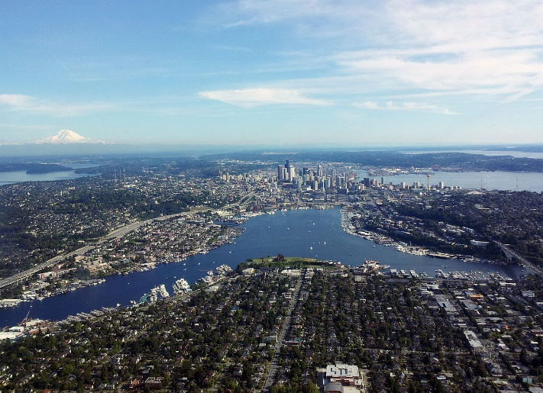
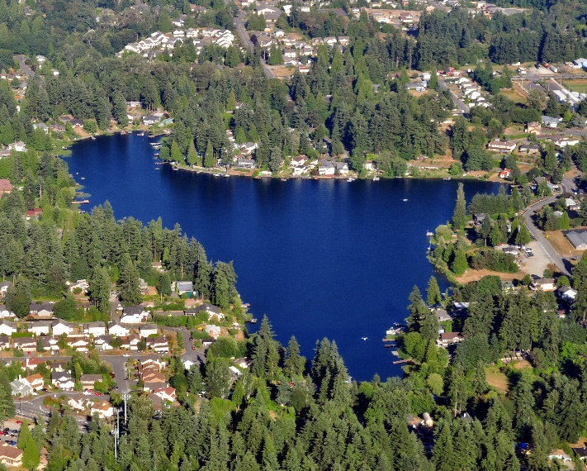
Basic structure of the model
You’ll create a new folder (directory) on your computer when you unzip the module folder.
Within this folder, you will have:
A meteorological CSV (‘met’) file that forces the model (e.g., met_hourly.csv)
‘nml’ text files that act as ‘master’ scripts for the model (e.g., glm2.nml, aed2.nml)
Inflow/outflow CSV files that specify the temperature, flow rate, and concentrations of phosphorus of connected streams entering and leaving the lake
Images: Wikimedia commons
Notes:
GLM requires a separate new folder/directory on each student’s laptop, which will be downloaded as an RStudio project.
Within this folder will be:
1) a CSV (comma-separated values) file, which has the climate driver data (also referred to as a ‘met’ file; or a file with the meteorological data. We call this ’met_hourly.CSV’),
2) one or more .nml files, which can be opened as a text file, and act as a master script to the GLM and AED models (they contain parameters for how the model should work, tell the model basic info on the lake, such as depth, latitude, time period of the simulation, etc.), and
3) inflow/outflow CSV files that specify the temperature, flow rate, and nutrient concentrations of the connected streams entering and leaving the lake.

Slide 15
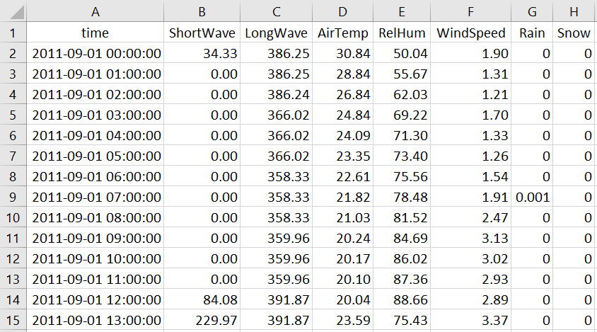
Example met file
Climate scenarios: +2°C, +4°C, or +6°C
Notes:
Here is an example met file, with columns for time step, shortwave radiation, longwave radiation, air temperature, relative humidity, wind speed, rain, and snow.
This met file is on an hourly time step.
For our climate change scenarios today, we will change the daily AirTemp by either 2, 4, or 6 degrees year-round, to see how changes in air temperature affect lake water temperatures. These scenarios are based on real climate warming projections between now and the year 2099 for the focal lakes.
Note to instructors: to examine other meteorological variables, we encourage you to check out Macrosystems EDDIE module #1 (Climate change effects on lake temperatures), which involves manipulating many variables simultaneously in which students design their own climate scenarios.
Note the DateTime structure of the time column: GLM requires this exact format of YYYY-MM-DD hh:mm:ss. GLM also requires that the column headers are spelled exactly like what is in this file (and are capitalization-specific). If this file is opened in Excel, it will corrupt the GLM timestamp.

Slide 16
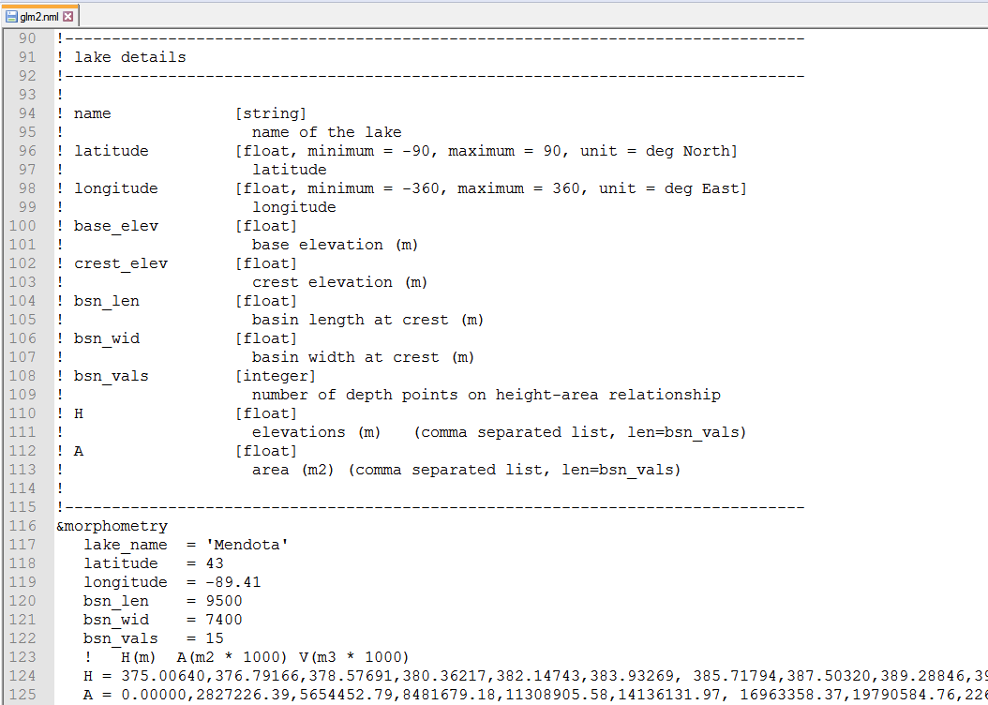
Example .nml file
Notes:
Here is an example .nml file, which goes through many required pieces of information, such as what the name of the lake being modeled is, its latitude/longitude, the time period being modeled, etc. You can open up an .nml file in a text editor program to make changes.
Fun fact: nml stands for “namelist” in the Fortran programming language.

Slide 17
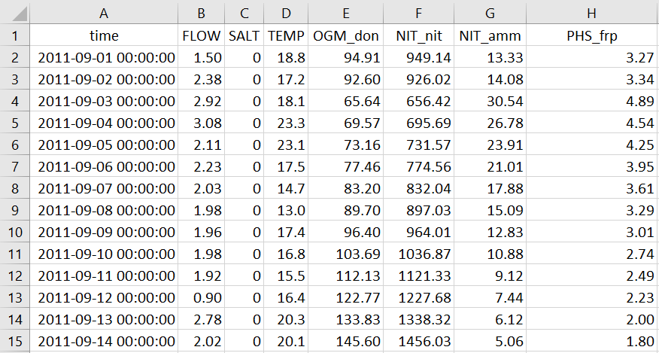
Example inflow file
Land use scenarios: 2×, 4×, or 6× P
Nitrogen
Phosphorus
PHS_frp = the type of phosphorus that phytoplankton take up.
High concentrations can promote blooms
Notes:
Here is an example inflow file, with columns for time step, water volume (FLOW), salt concentration, water temperature, and a number of columns for different types of nitrogen and phosphorus. This inflow file is on a daily time step.
For our land use change scenarios today, we’ll ONLY be changing the PHS_frp column, which represents the type of phosphorus that phytoplankton take up. The reason why we are focusing on phosphorus is because it is the limiting nutrient for phytoplankton in many lakes and also can increase in response to land use, especially increased sedimentation due to deforestation.

Slide 18

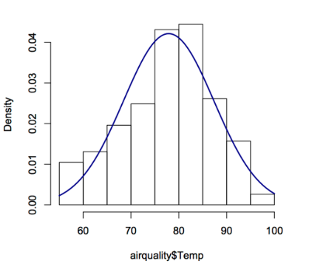
We will run GLM-AED using R
R is a statistical environment that can run on different computer operating systems (PC, Mac, Linux)
R is reproducible, free(!), and easy to download
R can run stats, make figures, and do a suite of different analyses in many disciplines
Many packages for R to merge with other tools (including GLM!)
We’ll walk you through each step of the script, so don’t worry if you’re new to R!
Notes:
We are going to run GLM in R, a programming language and statistical environment that is used for running statistics, making figures, and doing lots of different analyses.
Within R, you can download lots of different software ‘packages’ for different types of analyses.
The benefit to R is that it is free, runs on all operating systems, and is reproducible- i.e., any code that you write can be saved and run later, and you know exactly what you did!
R is the preferred programming language of many ecologists and provides a great entry level language for learning some basic coding skills that are used in many different career paths.

Slide 19
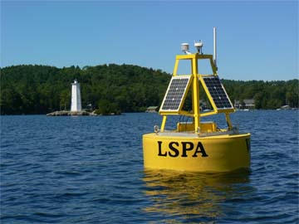
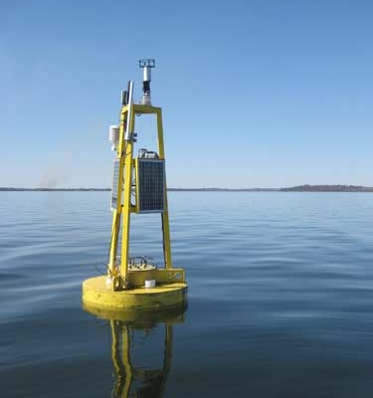
Lakes we’re going to model today
Lake Sunapee
(New Hampshire, USA)
Lake Mendota
(Wisconsin, USA)
Oligotrophic
Low nitrogen
Low phosphorus
Main land uses:
81% Forest
8% Urban
4% Agriculture
Eutrophic
High nitrogen
High phosphorus
Main land uses:
55% Agriculture
20% Urban
1% Forest
GLEON.org
engr.wisc.edu
Notes:
For today’s module, we’ll be comparing two REAL lakes that differ in their trophic state. Lake Sunapee is oligotrophic, with low nitrogen and phosphorus concentrations in the water, while Lake Mendota is eutrophic, with high nitrogen and phosphorus.
The two lakes also differ in the types of land use that dominate their watersheds; Sunapee is primarily forested, with limited areas of urban development and agriculture. In contrast, Mendota’s watershed is dominated by agriculture and urban development, with very limited forest.
Both lakes are members of the Global Lakes Ecological Observatory Network (GLEON), a grassroots organization of lake scientists, computer scientists, engineers and citizen scientists committed to sharing data and documenting change in water quality around the world. The data that we’ll be analyzing was graciously shared from GLEON researchers.

Slide 20
Learning objectives
Understand the concepts of macrosystems ecology and cross-scale interactions, and how different ecological processes can interact at local, regional, and continental scales.
Simulate phytoplankton blooms in multiple lakes using ecosystem models of lake water quality set up with publicly-available high-frequency sensor datasets (Activity A).
Test the effects of a climate scenario on the different lake models, and examine how the timing and intensity of phytoplankton blooms change with climate warming (Activity B).
Examine the effects of both local nutrient loading and regional climate forcing to determine how factors acting at different scales interact to affect the intensity and timing of phytoplankton blooms (Activity C).
Predict how lake phytoplankton blooms may respond globally to changing climate and land use.
Notes:
Learning objectives!
Talk through these with the students one by one: use the embedded animations to sequentially show each of the bullet points.
Most importantly, the goal here is to have students develop their own hypotheses for how climate and land use interact to affect different lakes, and then test their hypotheses by forcing the lakes with the climate and land use scenarios.
They will then make mini-presentations to share their findings with the class as part of Activity C.
A major goal is to compare how the lakes with different baseline water quality respond to the same climate change and land use change scenarios, and to see if cross-scale interactions occur– i.e., do both lakes respond to changes in drivers in the same way? Which driver is each lake most sensitive to? Let’s find out!

Slide 21
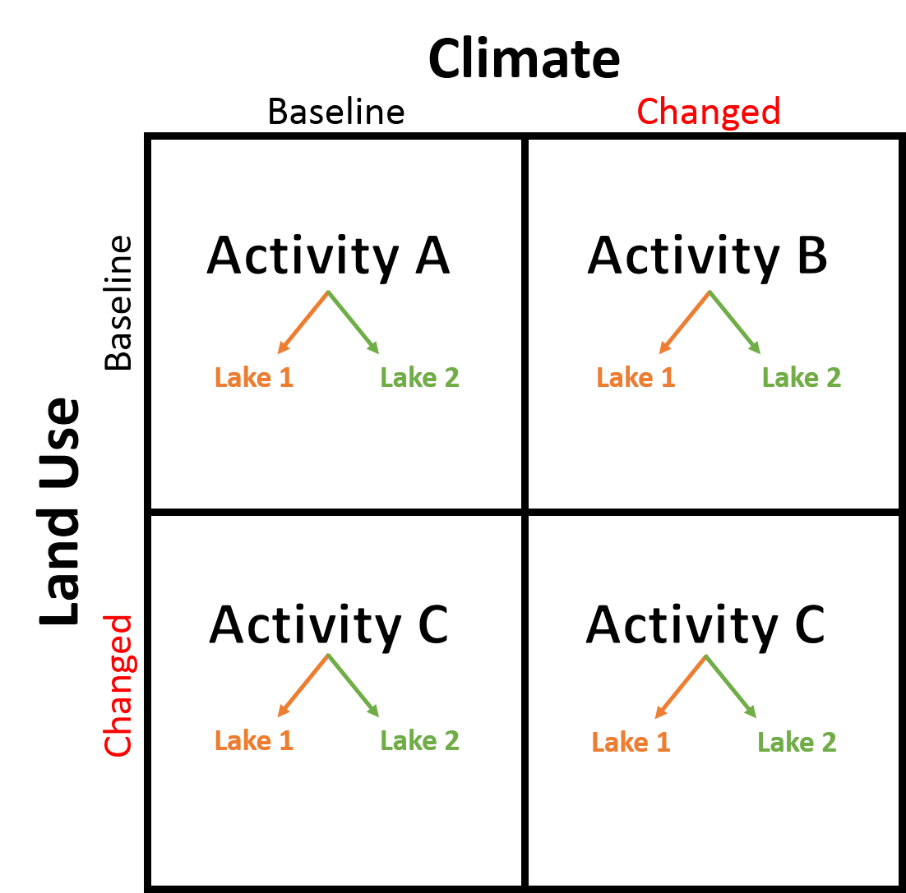
Workflow of module
We'll be using pre-made climate and land use scenarios based on real predictions for these lakes
+2°C, +4°C, or +6°C
2×, 4×, or 6× P
Notes:
Divide the students into teams of 4 students with 2 pairs each. In Activity A, one pair will model Mendota and one pair will model Sunapee using the baseline (observed) data.
In Activity B, the four students will work together to test a climate scenario, which one pair will apply to Mendota and the other will apply to Sunapee and compare how the phytoplankton respond in both lakes relative to the baseline conditions.
In Activity C, the four students will work together to test a land use scenario, which one pair will apply to Mendota and the other will apply to Sunapee. They can then compare all four possibilities of land use and climate change to determine a) in which scenario are phytoplankton blooms greatest, b) how the two lakes respond to the same forcing conditions, and c) if there are cross-scale interactions apparent in the lakes.
We encourage instructors to have their student teams choose different pairs of land use/climate change scenarios so that they can compare the strength of cross-scale interactions for their model output.

Slide 22

Discussion questions embedded in
your handout
Everyone will need to turn in the completed handout with question answers written out at the end of the module today.
We encourage you to work with your partner to complete the questions!
Image: newsfrom4j.wikispaces.com
Notes:
On your handout, there are questions for each section of the module. As you work through the module, be sure you’re writing down answers to each of the questions, as you’ll be turning these worksheets in at the end of class! Note to instructors: these could also be collected as homework, depending on the class’ experience level and which activities you plan to cover.

Slide 23
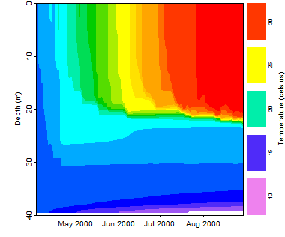
Activity A: Run a lake model!
With a partner (work in pairs):
Find the two lakes on a satellite map, and examine land use in their watershed
Coordinate with another pair of students so that each pair is modeling a different lake
Download the zipped folder of R scripts and other files to run this module. Extract to your desktop
Download GLM-AED files and R packages onto your computer
Run the model and look at the output for temperature and chlorophyll-a for your lake (make sure you save your plots as you go!)
Notes:
Introduce Activity A, which has 2 objectives divided among 5 tasks.
Download R packages and GLM files onto your computer and explore configuration files
Run the GLM model and explore the baseline model output for a lake.
Have students work in pairs as described earlier.
After you’ve introduced the steps of Activity A, stop the PowerPoint and let the students get started on Activity A.

Slide 24
Activity B: Climate change scenario
Working with the other pair of students, select one of the pre-made climate change scenarios for air temperature. Develop hypotheses about how changing air temperatures may affect water temperatures and chlorophyll-a in your model lakes
Modify your glm2.nml file to test your hypothesis
Run both model lakes with the same scenario
Analyze the model output to determine how the scenario changed water temperature and chlorophyll-a
Create a few figures (save them as you go!) to examine your climate scenario:
Does the model output support or contradict your hypothesis?
How does the output from the two lakes compare?
Which lake’s phytoplankton are more sensitive to the climate scenario? How can you tell?
Notes:
Introduce Activity B, which has two objectives:
Develop hypotheses about how changing air temperatures may affect water temperatures and chlorophyll-a in the model lakes and explore how lake responses to warming, in terms of phytoplankton blooms, differ between lakes. Make sure that all of the students record their hypotheses in their handout sheets.
Create figures to answer the handout questions on how the lakes are responding to altered climate.
The important take-home message here is that students need to 1) first discuss how they expect a change in air temperature in their climate scenario to affect lakes, and how responses may differ between the two model lakes, 2) run their climate scenario to test their hypothesis, and 3) explore if the model output from their scenario supports or contradicts their hypothesis.

Slide 25
Activity C: Climate and land use change
Working with the other pair of students, select one land use scenario for phosphorus inputs. Make hypotheses about how land use change will affect phytoplankton blooms. Modify the glm2.nml file, then run the model.
Now modify your glm2.nml file to change temperature and phosphorus simultaneously. Run the additional scenario for both lakes. You will now have 4 scenarios (no change, climate change only, land use only, and land use + climate change) for each lake.
Create a few figures (save them as you go!) to highlight your 4 scenarios & share with the class!
Does the model output support or contradict your hypotheses?
How does the output from the two lakes compare?
Are the phytoplankton in your lake more sensitive to climate change, land use change, or both? How does this compare among different lakes?
Do your lakes show evidence of cross-scale interactions? Why or why not?
Predict how lake phytoplankton blooms may respond to changing climate globally, given different land uses.
Notes:
Introduce Activity C., which has 2 objectives.
Select a land use change scenario and explore how it will affect two lakes’ thermal structure and chlorophyll-a concentrations. Then combine the land use and climate scenarios to test for cross-scale interactions.
Create figures to share with the class that demonstrate the model output for the four total scenarios run for each lake.

Slide 26


Evidence for Cross-Scale Interactions?
Phytoplankton blooms are driven by processes occurring at different scales:
Increasing lake nutrients (local)
Warming climate (regional)
In your lake, did you observe cross-scale interactions in phytoplankton bloom timing and/or intensity?
Only climate had an effect
Only land use had an effect
Climate and land use had interacting effects
Were these effects linear or non-linear?
How would your understanding of phytoplankton blooms be different if you had looked at just climate or land use changes in isolation?
NOAA
Notes:
As a culminating check-in, ask students if they believe they have observed cross-scale interactions in their lake through the different scenarios. We define a response as a cross-scale interaction if both climate and land use interacted to affect chlorophyll in the combined scenario. If, for example, the combined climate and land use scenario response is identical to the effect of climate change alone, then land use had no effect and it was not a cross-scale interaction. However, it is unlikely in the students’ scenarios that they don’t observe cross-scale interactions because both drivers likely will contribute to variation in chlorophyll over time.
If the combined climate and land use scenario had an interactive effect on phytoplankton bloom intensity or timing, we can then ask students if their observed response was additive, synergistic, or antagonistic.
Finally, challenge them to think about how their understanding of phytoplankton blooms would be different if they had only examined climate or land use changes in isolation.

Slide 27

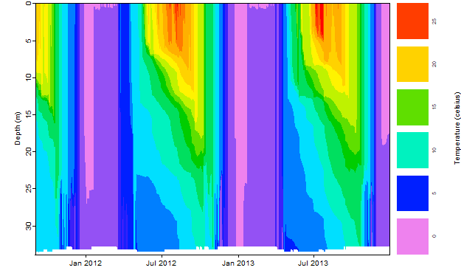
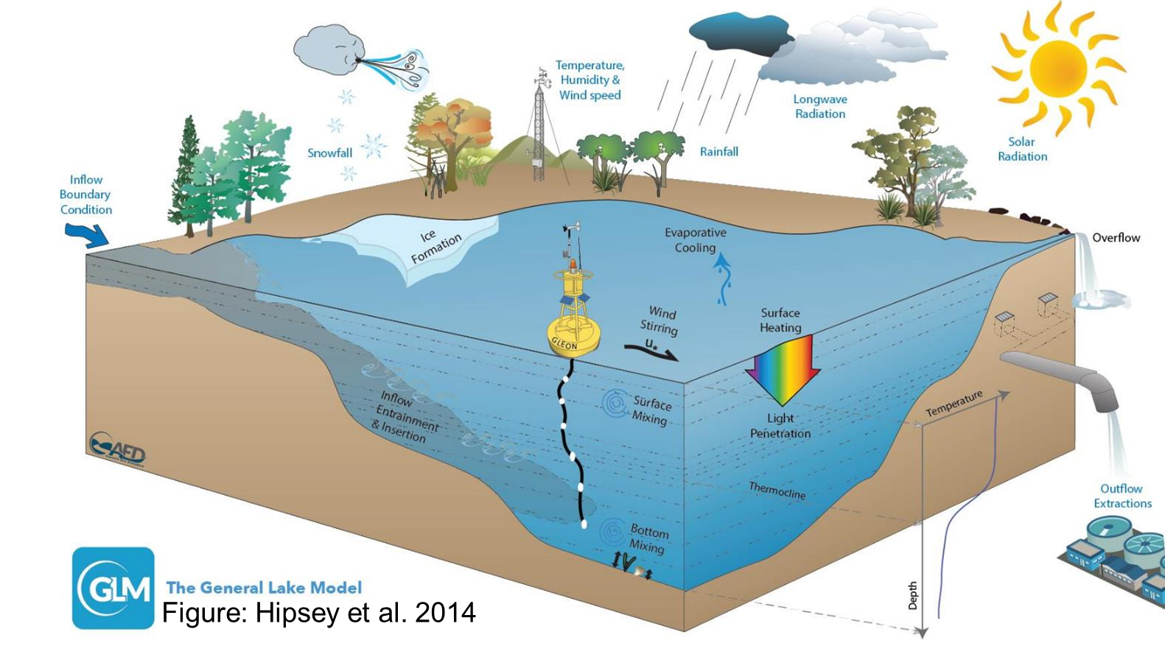
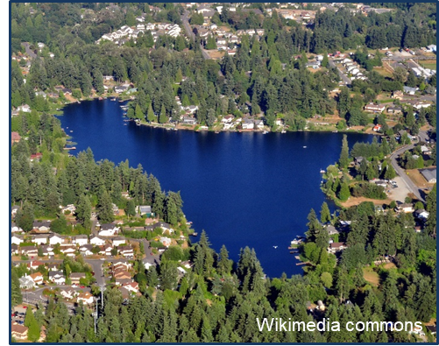
Thank you for participating!

Slide 28
Optional additional slides
Depending on your class and the time available, you may want to include some of the following slides for discussion of the module concepts
Notes:
Depending on your class and the time available, you may want to include some of the following slides for discussion of the module concepts:

Slide 29
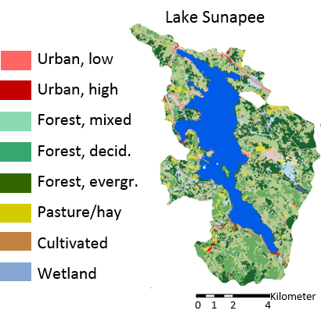
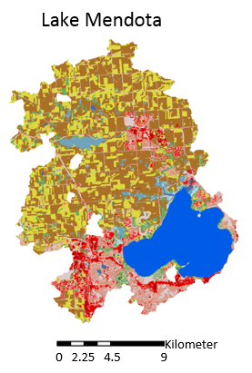
Lakes we’re going to model today
Maps: LAke multi-scaled GeOSpatial and temporal database (lagoslakes.org)
Notes:
If we look at watershed land use maps for the two lakes, you can clearly see the differences between Sunapee and Mendota; with high forest cover in Sunapee, and a mixture of agriculture and urban development in Mendota.
In today’s module, we’re interested in understanding how land use differences between lakes affect how they respond to climate and land use change. As part of the module, you’ll look up where these lakes are located in Google Earth/Google Maps and compare their watersheds.

Slide 30
What are the possible cross-scale interactions between climate and land use?
Notes:
There are multiple different types of cross-scale interactions, some linear and some non-linear. By looking at chlorophyll responses to the climate scenario only, land use scenario only, and combined climate and land use scenarios relative to baseline conditions, we can classify the cross-scale interactions as additive (linear), synergistic (non-linear), or antagonistic (non-linear).
As part of Activity C, we ask students to compare how the chlorophyll in the climate and land use change scenario compares with the individual land use only and climate change only scenarios. This figure demonstrates what an additive relationship looks like- i.e., if climate increases chlorophyll by 2 ug/L and land use increases chlorophyll by 7 ug/L, then the joint climate + land use scenario increases chlorophyll by 9 ug/L.
These slides may be helpful if students have questions about the definitions of additive, synergistic, and antagonistic as they analyze their chlorophyll a time series.

Slide 31
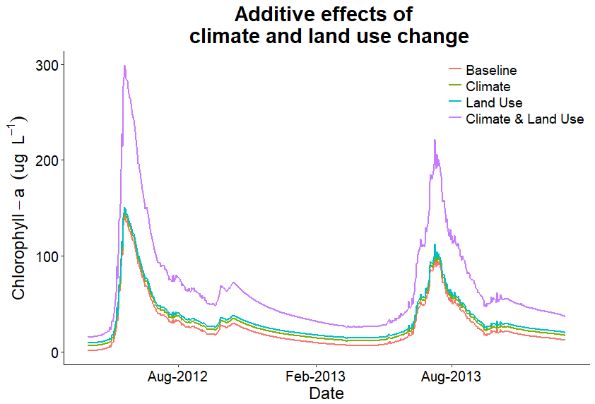
What are the possible cross-scale interactions between climate and land use?
Notes:
This is an example of an additive chlorophyll a time series. We classify it as a linear cross-scale interaction between the effect of the climate scenario + the effect of the land use scenario = the effect of the combined climate + land use scenario.

Slide 32
What are the possible cross-scale interactions between climate and land use?
Notes:
This figure demonstrates what a synergistic relationship looks like- i.e., if climate increases chlorophyll by 5 ug/L and land use increases chlorophyll by 5 ug/L, then the joint climate + land use scenario increases chlorophyll by more than 10 ug/L. Synergism implies that the sum of the parts is much greater than each of their individual contributions.

Slide 33
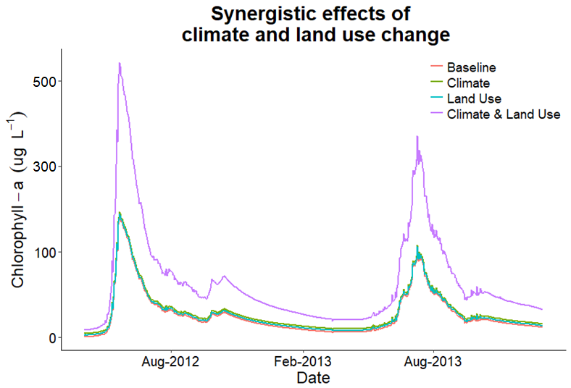
What are the possible cross-scale interactions between climate and land use?
Notes:
This is an example of a synergistic chlorophyll a time series. We classify it as non-linear because you cannot predict what the effect of the combined climate and land use scenario will be from the individual climate and land use scenarios.

Slide 34
What are the possible cross-scale interactions between climate and land use?
Notes:
This figure demonstrates what an antagonistic relationship looks like- i.e., if climate increases chlorophyll by 5 ug/L and land use increases chlorophyll by 5 ug/L, but the joint climate + land use scenario is less than 10 ug/L. Antagonism implies that the sum of the parts is less than the sum of the individual contributions.

Slide 35
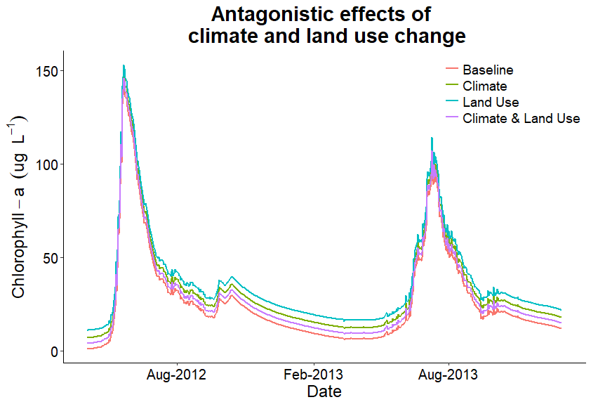
What are the possible cross-scale interactions between climate and land use?
Notes:
This is an example of an antagonistic chlorophyll a time series. We classify it as non-linear because you cannot predict what the effect of the combined climate and land use scenario will be from the individual climate and land use scenarios.

Slide 36
What are the possible mechanisms underlying these patterns?
Additive effects could happen when a lake is much more sensitive to one driver than another (linear CSI)
e.g., an already-warm lake with low nutrients is likely more sensitive to land use than climate change
Synergistic effects could happen when a lake is equally sensitive to both factors, so increasing P and temperature simultaneously could trigger non-linear increases in blooms
Antagonistic effects could happen when a lake is not sensitive to either factor, so the two factors cancel each other out non-linearly
e.g., adding more nutrients and increased temperatures to an already-warm lake with high nutrients may inhibit phytoplankton growth if optimal thermal and nutrient conditions are exceeded
Notes:
Discuss potential mechanisms that might explain the three types of interaction shown on the previous slides.
Additive effects are linear CSI; synergistic and antagonistic effects are non-linear CSI

Slide 37
Thank you for participating!

